Slide 1
Discrete Event
Simulation Lab
A semi automatic translator from System Dynamics to Modelica with application to socio-bio-physical systems
Rodrigo Castro¹, Mariano Zapatero¹, Peter Fritzson²
1 Laboratorio de Simulación de Eventos Discretos (SED) Departamento de Computación (DC), Instituto de Ciencias de la Computación (ICC) Universidad de Buenos Aires and ICC-CONICET, Argentina.
2 Programming Environment Lab, Linköping University, Sweden
OpenModelica Workshop
“Trusting the models for complex systems”
February 6, 2023
Location: Linköping University, Sweden

Slide 2
Agenda
The EARTH3 Global Systems Model (A predecessor of Earth4All)
Dynamic socio-bio-physical System Simulation
Unification of the modeling paradigm: Modelica
The sources: spreadsheets and Vensim model
System Dynamics in a nutshell
Automated XMILE to Modelica translation
Model results
Simulation validation
Conclusions and Future Work
2
Notes:
https://peerj.com/articles/4526/

Slide 3
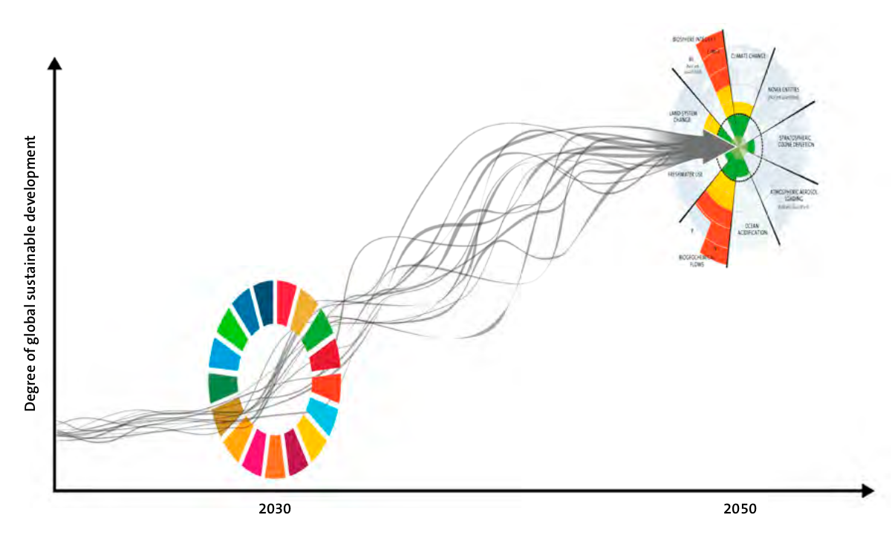
Introduction
“Transformation is feasible” How to achieve the Sustainable Development Goals (SDG) within Planetary Boundaries (PB) (2018)
A report to the Club of Rome for its 50 years anniversary
Humanity’s grand ambition: to aim at an inclusive and prosperous world development within a stable and resilient Earth system
Degree of sustainable development
9 PBs
17 SDGs
2030
2050
Randers, J., Rockström, J., Stoknes, P. E., Goluke, U., Collste, D., Cornell, S. E., & Donges, J. (2019). Achieving the 17 Sustainable Development Goals within 9 planetary boundaries. Global Sustainability, 2, e24.
3

Slide 4
Introduction
“Transformation is feasible” How to achieve the Sustainable Development Goals (SDG) within Planetary Boundaries (PB) (2018)
A report to the Club of Rome for its 50 years anniversary
Humanity’s grand ambition: to aim at an inclusive and prosperous world development within a stable and resilient Earth system
Goal: To attain as many of the 17 SDGs as possible by 2030, and then continue following a sustainable global trajectory
The report identifies potentially feasible pathways to success through 5 transformative and synergistic actions.
Supporting Model: EARTH3 - A Global Systems Model to mimic the development over time in 7 regions towards 2050 linking socio-economic and biophysical processes. (Note: Earth3 has developed into Earth4All 2023)
Integrated scenario analyses of pathways to attain SDGs within Planetary Boundaries (PB)
Degree of sustainable development
9 PBs
17 SDGs
2030
2050
Randers, J., Rockström, J., Stoknes, P. E., Goluke, U., Collste, D., Cornell, S. E., & Donges, J. (2019). Achieving the 17 Sustainable Development Goals within 9 planetary boundaries. Global Sustainability, 2, e24.
4

Slide 5
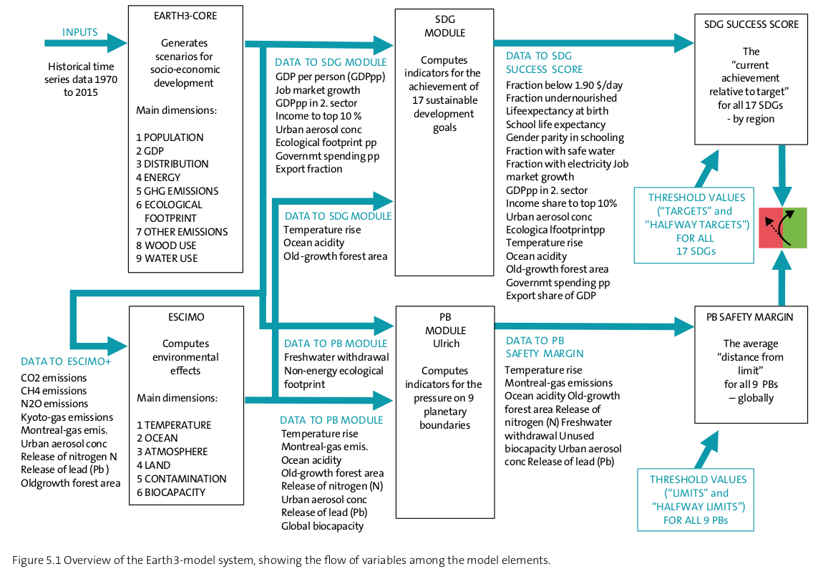
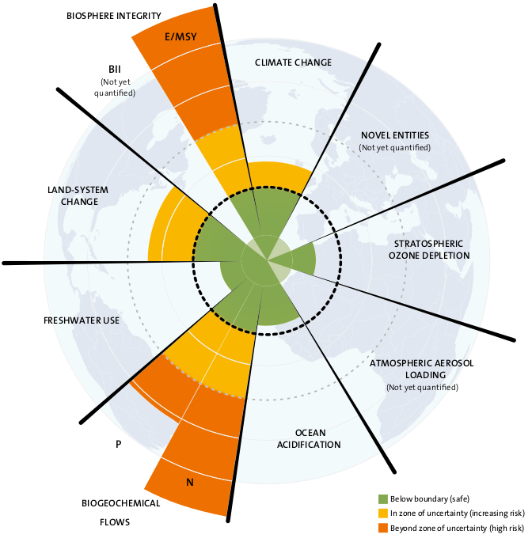
EARTH3-model system
Indicators
Targets Results
Dynamic Socio-bio-physical System Simulation
5

Slide 6
EARTH3-model system
Dynamic Socio-bio-physical System Simulation
6

Slide 7
EARTH3-model system
EARTH3-CORE
Forecasts of the level of human activity from 2015 to 2050, by region.
Modeling paradigm: Spreadsheet
(discrete time, tabular)
Dynamic Socio-bio-physical System Simulation
ESCIMO “Earth System Climate Interpretable Model”
Biophysical effects arising from the
human activity, from 2015 to 2050.
Modeling paradigm: Forrester’s System Dynamics (continuous time, stocks and flows)
7

Slide 8
EARTH3-model system
EARTH3-CORE
Forecasts of the level of human activity from 2015 to 2050, by region.
Goal
Unify the modeling paradigm:
Standardized, Tool independent, Object Oriented, Equations Based.
Dynamic Socio-bio-physical System Simulation
ESCIMO “Earth System Climate Interpretable Model”
Biophysical effects arising from the
human activity, from 2015 to 2050.
8

Slide 9
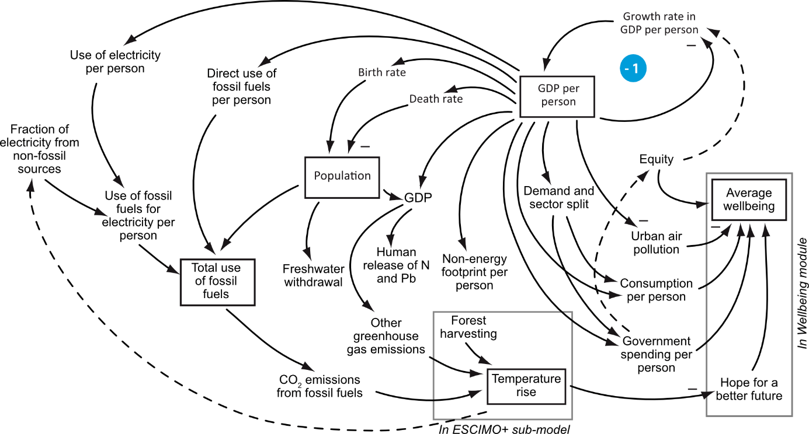
The causal structure of the spreadsheet-based Earth3-core sub-model
EARTH3-core
Causal diagram view
ESCIMO

Slide 10
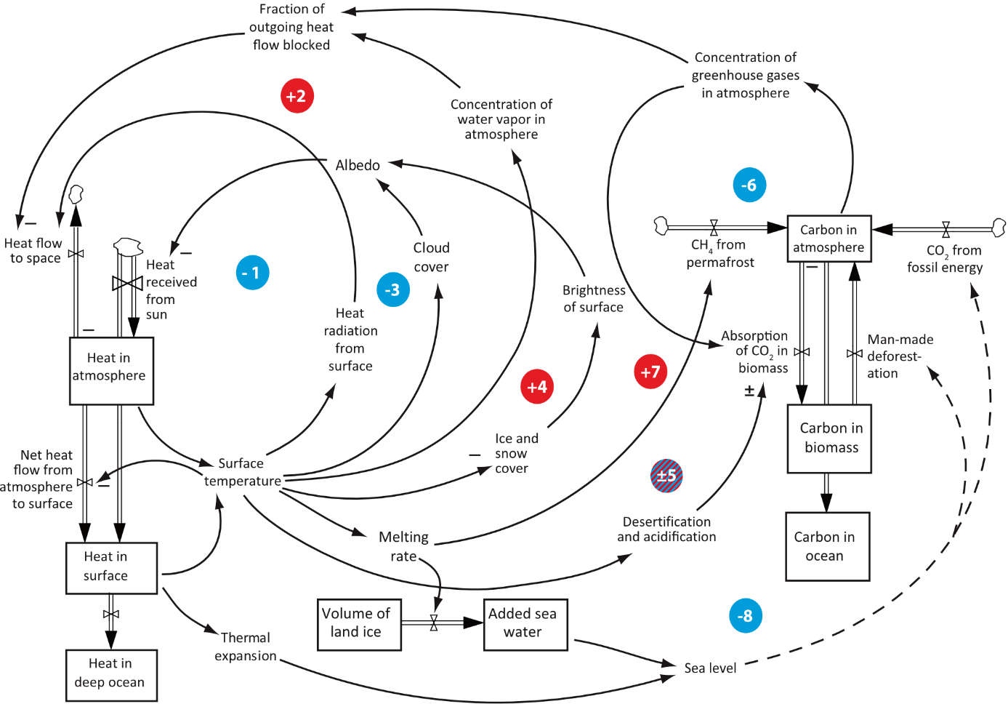
The causal structure of the System Dynamics ESCIMO-plus sub-model
ESCIMO
Stock and Flow view

Slide 11
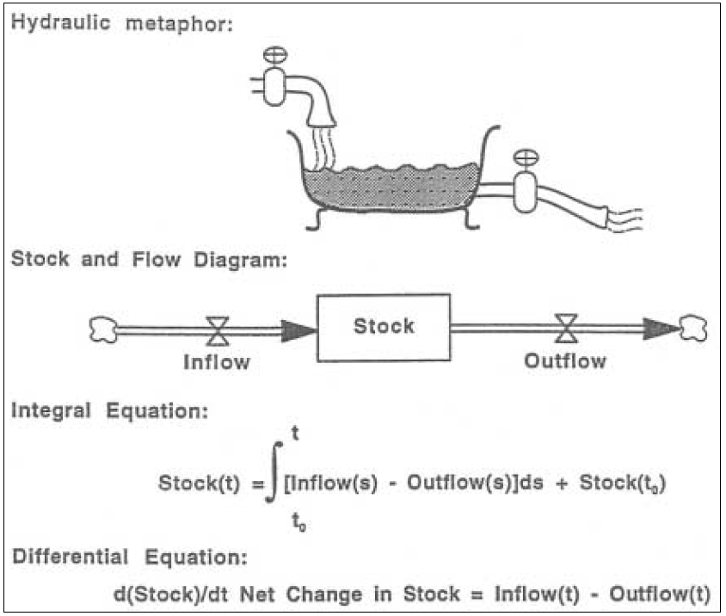
System Dynamics in a nutshell - The bathtub (Stock and Flow) metaphor
Inflow
Stock
Outflow
https://sites.google.com/site/protractedlearning/
11

Slide 12
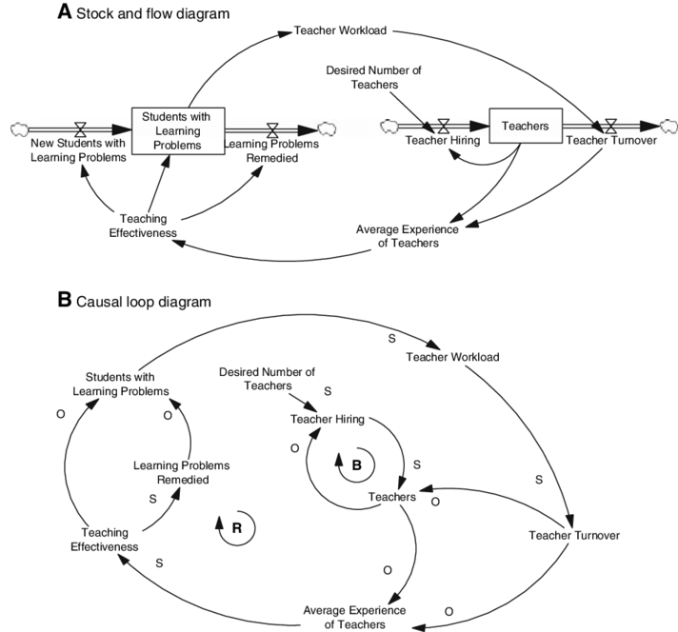
System Dynamics in a nutshell - Stock and Flow & Causal loop diagrams
Inflow
Stock
Outflow
Simulatable
Conceptual
https://sites.google.com/site/protractedlearning/
“Balancing”
Example:
“Reinforcing”
Hirsch, G. B., Levine, R., & Miller, R. L. (2007). Using system dynamics modeling to understand the impact of social change initiatives. American Journal of community psychology, 39, 239-253.
12

Slide 13
Approach
Currently, there are no feedbacks from ESCIMO back to Earth3-core
Therefore:
The outputs of Earth3-core sub-module can be precalculated and further fed as inputs to drive the ESCIMO sub-system simulation
Can be done by preloading Earth3-core time series
Using the Modelica Record or Blocks.Tables
Key task: Automatically translate the ESCIMO model from System Dynamics into Modelica
13

Slide 14
System Dynamics to Modelica automatic translation: How?
OASIS XML Interchange Language (XMILE) for System Dynamics (SystDyn)
Non-profit standards body
XMILE: Describes SystDyn model exchange XML files between SystDyn simulators
Specification created in 2013 by the IEEE in conjunction with IBM
https://www.oasis-open.org/committees/tc_home.php?wg_abbrev=xmile
Latest version: http://docs.oasis-open.org/xmile/xmile/v1.0/xmile-v1.0.html

Slide 15
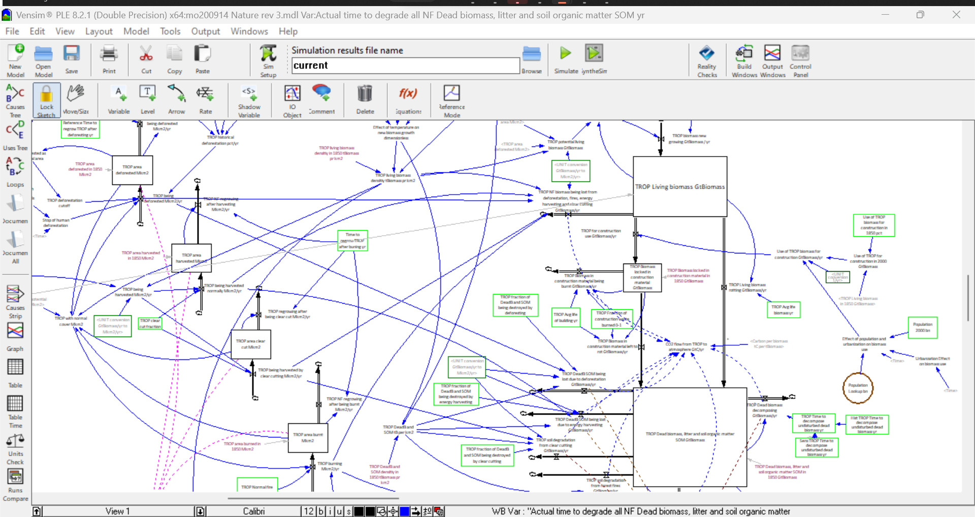
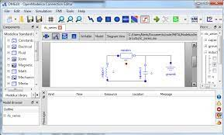
System Dynamics to Modelica automatic translation: How?
OASIS XML Interchange Language (XMILE) for System Dynamics (SystDyn)
Non-profit standards body
XMILE: Describes SystDyn model exchange XML files between SystDyn simulators
Specification created in 2013 by the IEEE in conjunction with IBM
https://www.oasis-open.org/committees/tc_home.php?wg_abbrev=xmile
Latest version: http://docs.oasis-open.org/xmile/xmile/v1.0/xmile-v1.0.html
We created an XMILE-to-Modelica translator
Quasi comprehensive: Scope sufficient to fully translate the ESCIMO model
XMILE 1.0
export
translate
ESCIMO
load
15

Slide 16
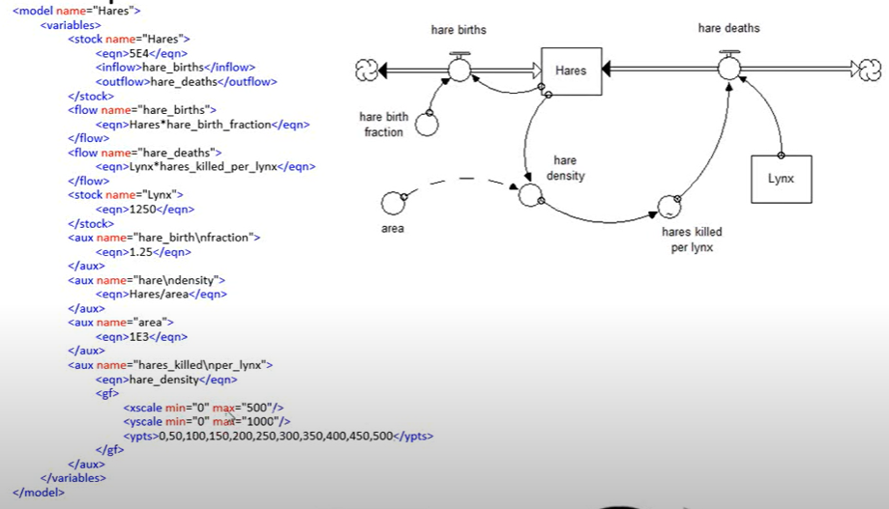
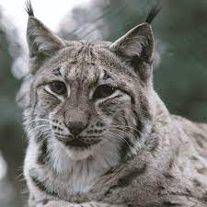
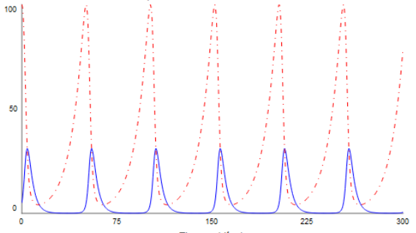
Illustrative example. Typical elements of a simple XMILE file structure.
Stock And Flows
Flow Eqn.
Aux Eqn.
Typical prey-predator population dynamics
Constant
https://www.youtube.com/watch?v=W7XIBUQ9CS4 Introduction to XMILE - An open standard for System Dynamics modeling
16

Slide 17
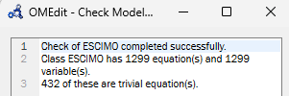
System Dynamics elements of the ESCIMO model that need translation
XMILE Element Type | Number in ESCIMO
STOCK | 77
IN FLOW Eqn. | 103
OUT FLOW Eqn. | 111
AUX Eqn. | 754
IF THEN ELSE | 99
“Undefined variables” | 82
SAMPLE IF TRUE | 12
WITH LOOKUP | 28
STEP | 3
GF | 1
ZIDZ | 4
PULSE_TRAIN | 1
DELAY1I | 2
DELAY3 | 1
DELAY3I | 1
SMOOTH | 6
SMOOTH3 | 1
Total | 1286
1286 XMILE elements to be translated to Modelica
Purely equation-based strategy:
No modularization (yet) for ESCIMO in Modelica
Large, flat Modelica system of equations
Undefined variables
82 (out of 1286) are parameters that needed to be imported semi automatically from the Earth3-Core Excel spreadsheet.
The SystDyn-to-Modelica parser features a module for extracting data from Excel and produce Modelica objects, such as the Modelica.Blocks.Tables.CombiTable1D lookup tables.
17

Slide 18
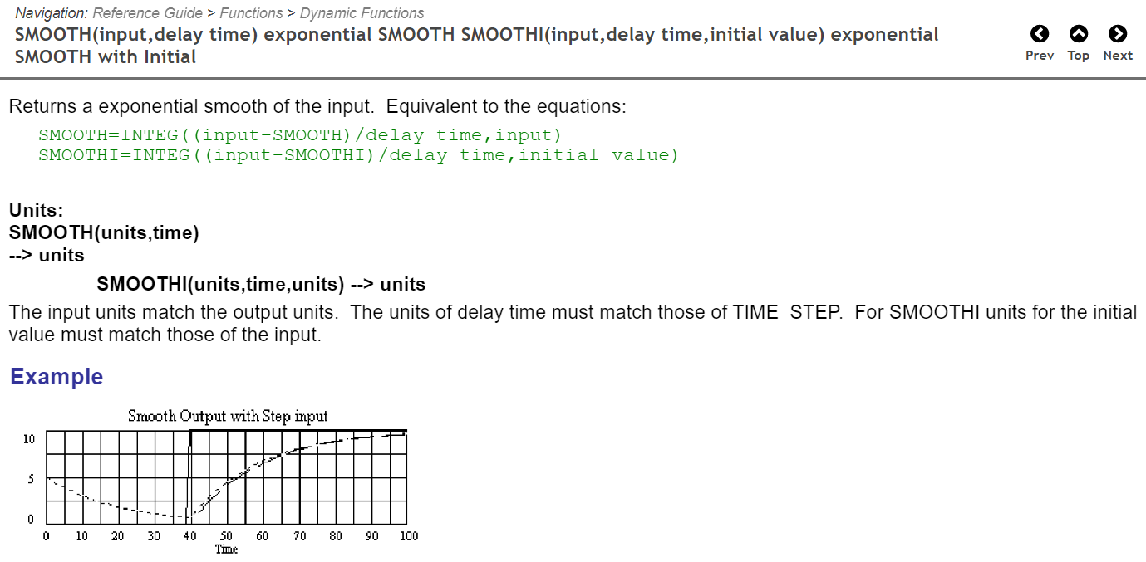
Example translated dynamical functions: “SMOOTH” in System Dynamics
VENSIM Help Interface for System Dynamics SMOOTH Function (1st order exponential delay)
Example snippet
Actual mathematical specification: 2 integrators with a reference
XMILE Representation for an ESCIMO variable
Modelica translation for an ESCIMO variable
18

Slide 19
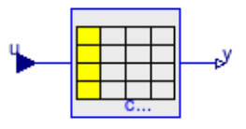
Example of a CombiTable1D block translated from an Excel time series
Time series from Earth 3 for Scenario 1 (“Business as usual”):
Example: CO2 emissions from fossil use - GtCO2/yr converted to GtC (Giga Tons of Carbon)
Translation:
Modelica.Blocks.Tables.CombiTable1Ds combi_E3_SC_1_CO2_GtC_yr(
tableOnFile = false,
table = [ 1970, 3.332195420498365; 1975, 4.081377867154944;
1980, 4.6501831166304815;
1985, 4.8193184244751865;
1990, 5.402814889258581;
...
2045, 8.46738722844944;
2050, 8.076591996852352]
) "E3 EXCEL COMBI_TABLE";
function E3_EXCEL_E3_SC_1_CO2_GtC_yr
output Real ret;
algorithm
ret := combi_E3_SC_1_CO2_GtC_yr.y[1];
end E3_EXCEL_E3_SC_1_CO2_GtC_yr;
Modelica.Blocks.Tables
Blocks for one- and two-dimensional interpolation in tables.
19

Slide 20
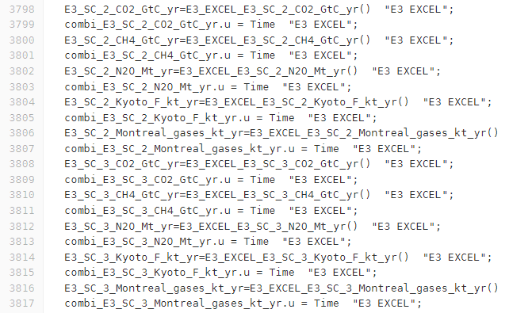
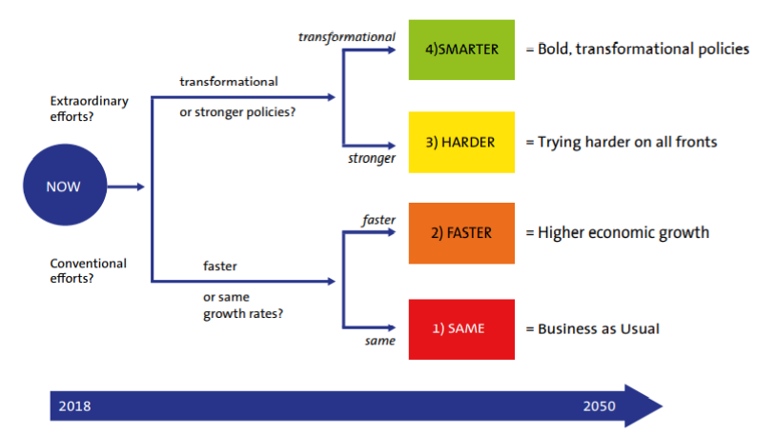
Scenario switching in Modelica ESCIMO - 4 socio-economic scenarios
…
SC2
From Earth3-core
SC4
SC3
SC3
SC2
…
SC1
20

Slide 21
Other example translated snippets for ESCIMO
…
…
…
…
Constants
Declaration of variables
Initial values for State variables
Auxiliary algebraic equations
21

Slide 22
Other example translated snippets for ESCIMO
…
…
Inflow
Outflow
+
-
State variable (SysDyn “stock”)
Flows named explicitly, can be reused for multiple inflows and/or outflows in multiple stocks
22

Slide 23
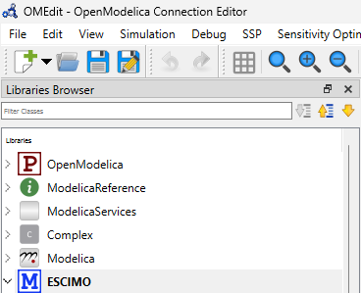
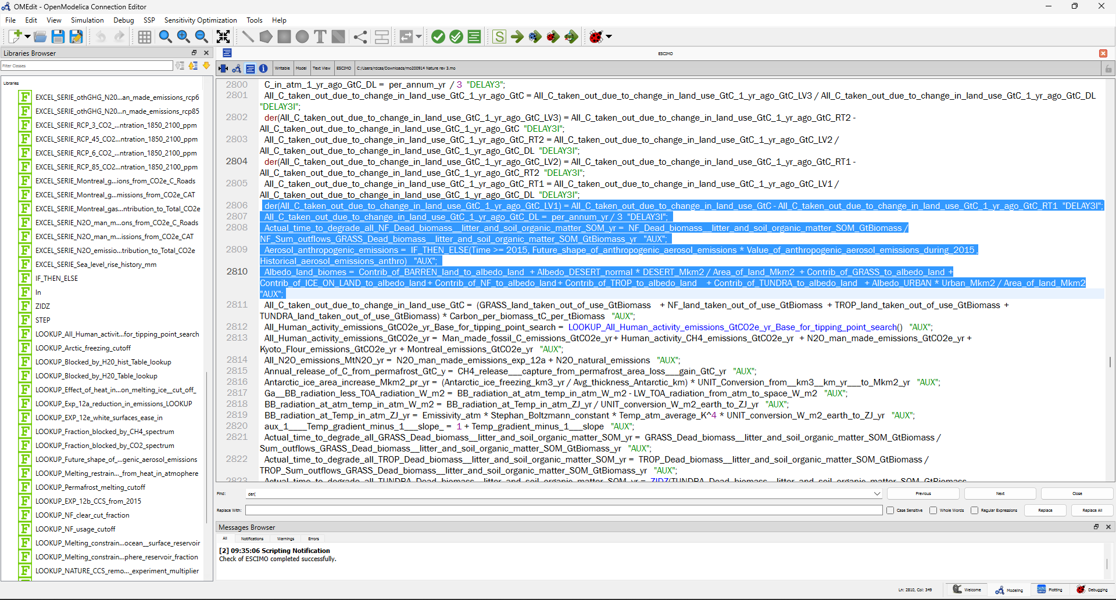
Results - Model
3900 lines of translated equations
23

Slide 24
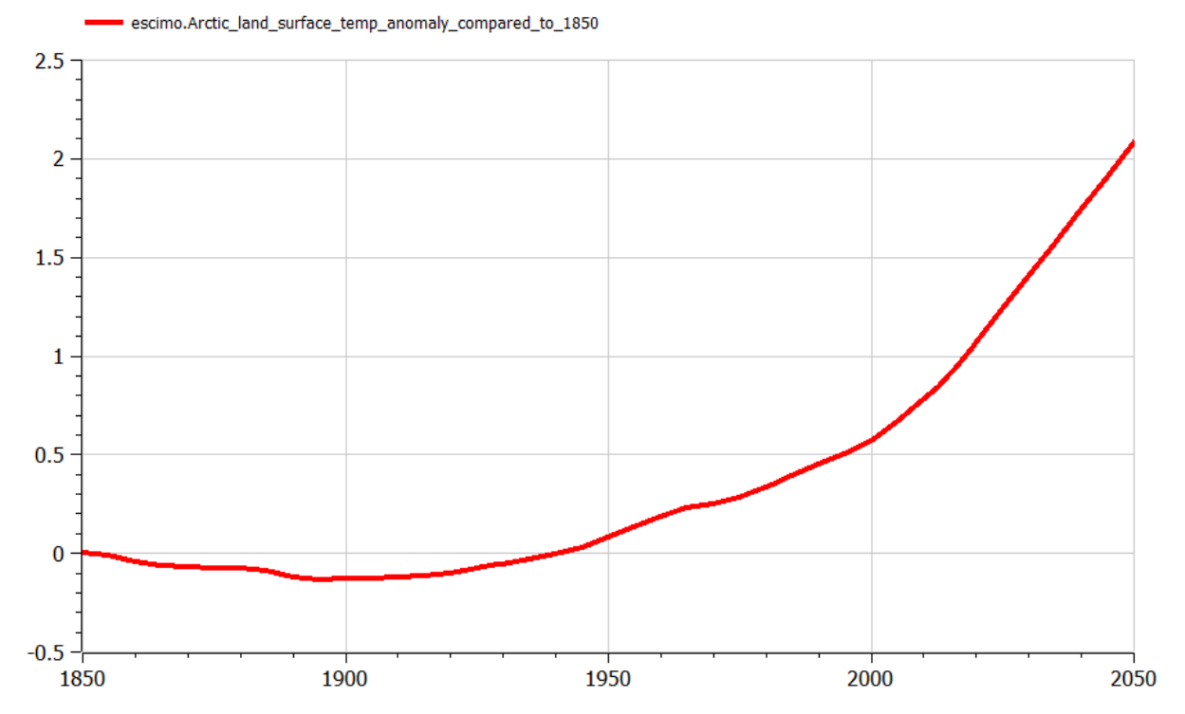
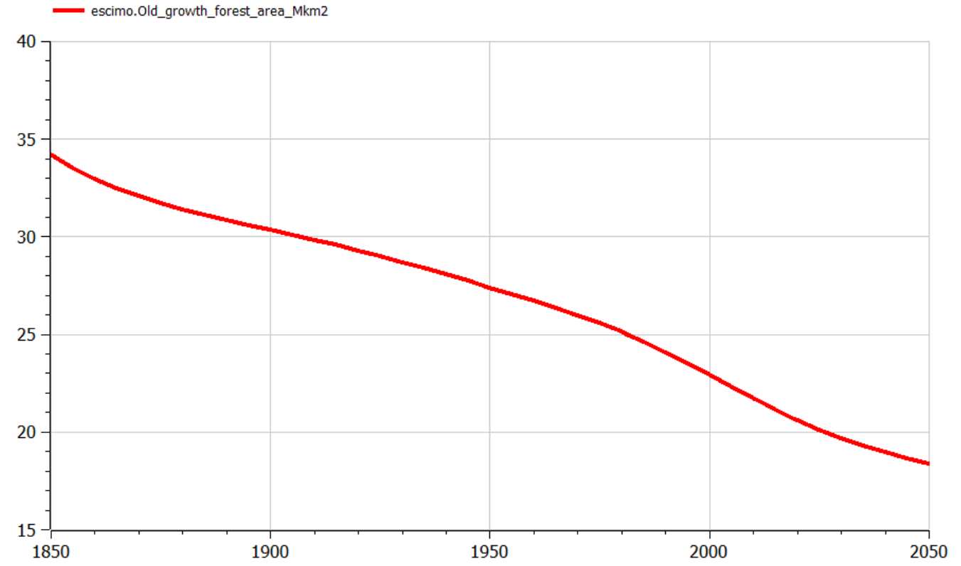
Validation of Modelica ESCIMO
Deviation of OpenModelica ESCIMO values vs. Vensim ESCIMO values for time series 1980-2050: Below 5%
A combination of:
Rounding errors when importing parameter values from EXCEL Earth3-Core spreadsheet into ESCIMO
Implementations of the underlying numerical solver
Overall result:
All resulting evolutions for the Planetary Boundaries and Sustainable Development Goals met in all 4 scenarios are true to the original EARTH3 system (see next slide).
Example ESCIMO results
Example ESCIMO results
24

Slide 25
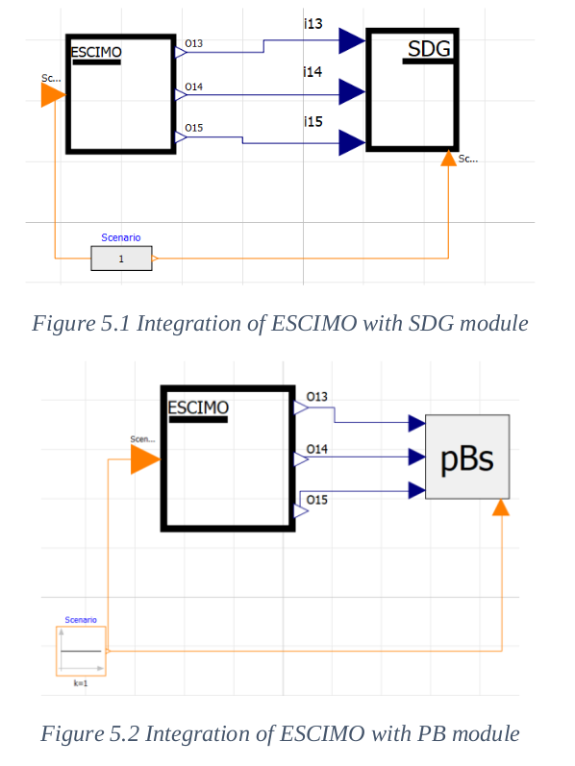
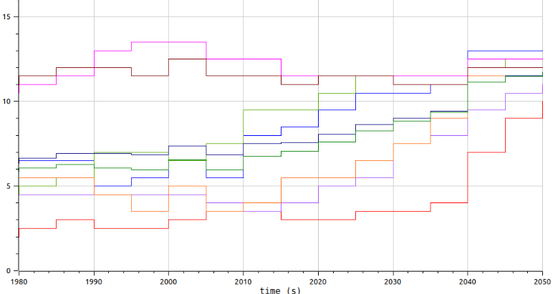
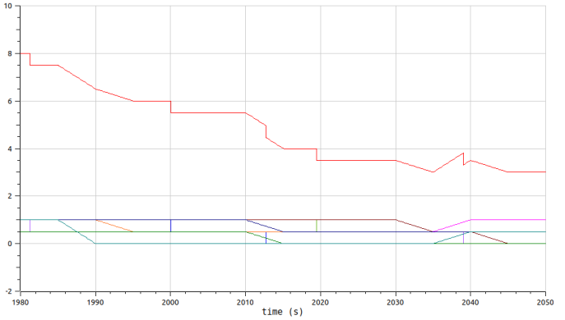
Integration of Modelica ESCIMO into the full Modelica EARTH3
Integration by ModeliCon, India
Example: Scenario 1 . “Business as Usual”
SDGs Success Score (0-17)
Scenario selector
1980
2050
Safe Planetary Boundaries (0-9)
Scenario selector
1980
2050
25

Slide 26
Conclusions and Future Work
Simulation-based assessment of socio-bio-physical systems necessarily involves a wide range of knowledge domains.
Different scientific disciplines are accustomed to using different tools and languages to express their models.
This leads to an ecosystem of modelling techniques that can undermine the development of more complex systems.
In this work, we propose to use Modelica as a unified, formal and standard language to integrate models created in spreadsheets and System Dynamics.
We gained the ability to extract models from any tool that can export System Dynamics to XMILE and create a correct and equivalent Modelica model using a new semi-automatic parser and translator.
The existence of standard intermediate representation formats such as XMILE has been fundamental in achieving this goal.
As future work, it remains to increase the number of functions and blocks translated from XMILE to Modelica, since for the present project we restricted the scope to what is necessary to meet the needs of ESCIMO.
26

Slide 27
Discrete Event
Simulation Lab
Thank you!
Questions?
Contact: Rodrigo Castro (rcastro@dc.uba.ar) Peter Fritzson (peter.fritzson@liu.se)
“Trusting the models for complex systems”
February 6-8, 2023
Location: Linköping University, Sweden

Slide 28
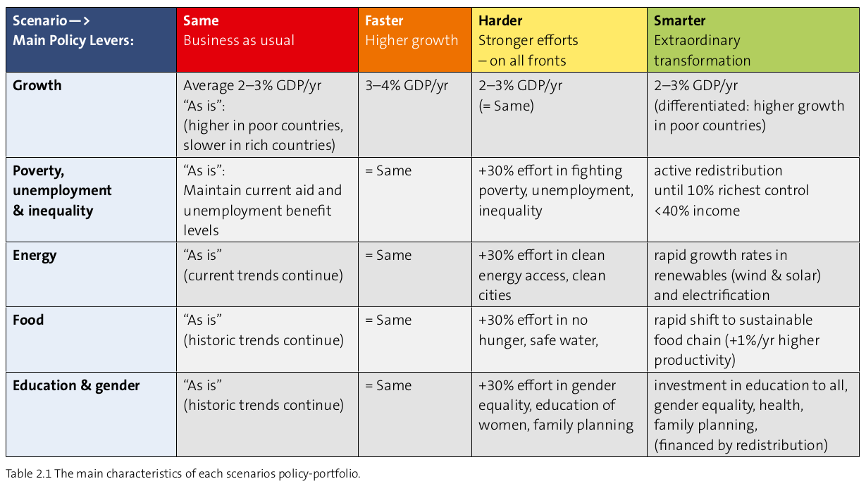
Scenarios
Randers, J., Rockström, J., Stoknes, P. E., Goluke, U., Collste, D., Cornell, S. E., & Donges, J. (2019). Achieving the 17 Sustainable Development Goals within 9 planetary boundaries. Global Sustainability, 2, e24.
28

